Slide 1
Cutting Stock using Python and AMPL
By Nicholas Crawford

Slide 2
What is the cutting stock problem?
Cut standard size pieces of material into specified sizes while minimizing waste.
Example: Suppose that rolls are produced in a uniform width of 100 inches and that orders can be placed for rolls of widths 14 inches, 31 inches, 36 inches, and 45 inches. The company has received the following orders
Order Width | Quantity Ordered
14 | 211
31 | 395
36 | 610
45 | 97

Slide 3
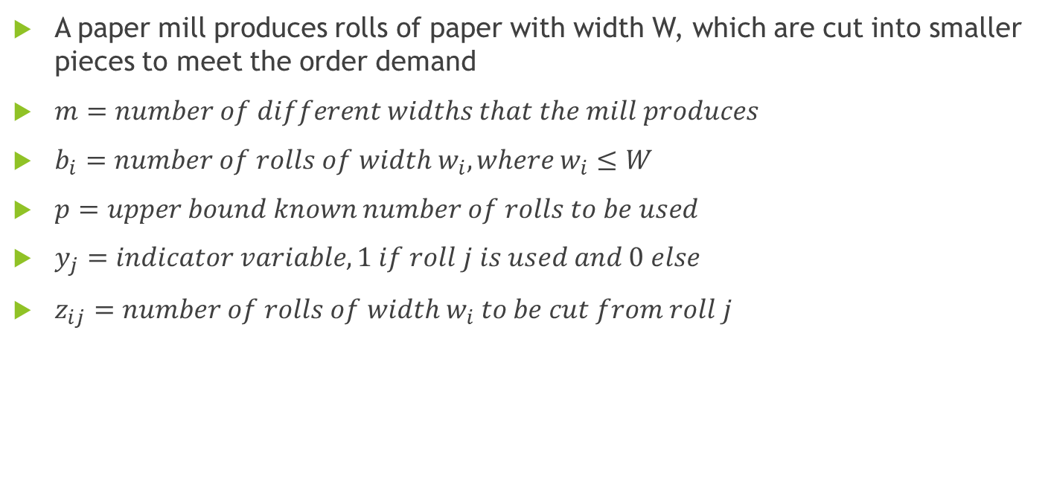
Mathematical Formulation
A paper mill produces rolls of paper with width W, which are cut into smaller pieces to meet the order demand
$m=number of different widths that the mill produces$
$b_{i}=number of rolls of width w_{i},where w_{i}≤W$
$p=upper bound known number of rolls to be used$
$y_{j}=indicator variable, 1 if roll j is used and 0 else$
$z_{ij}=number of rolls of width w_{i} to be cut from roll j$

Slide 4
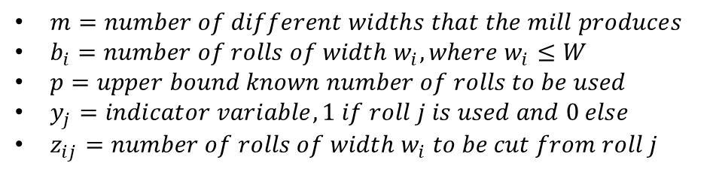

Mathematical Formulation cont’d
$m=number of different widths that the mill produces$
$b_{i}=number of rolls of width w_{i},where w_{i}≤W$
$p=upper bound known number of rolls to be used$
$y_{j}=indicator variable, 1 if roll j is used and 0 else$
$z_{ij}=number of rolls of width w_{i} to be cut from roll j$
$$\min{\sum_{j=1}^{p}{y_{j}}} \\ subject to:\sum_{i=1}^{m}{w_{i}z_{ij}≤Wy_{j} j=1,…,p} \\ \sum_{j=1}^{p}{z_{ij}≥b_{i} i=1,…,m} \\ y_{j}∈\left\{0,1\right\} j=1,…,p \\ z_{ij}∈ℤ^{+} i=1,…,m, j=1,…,p$$

Slide 5
Problems with the formulation
This is very computationally expensive
The bound from the linear relaxation is can be far from the integer solution
We need a better formulation!

Slide 6
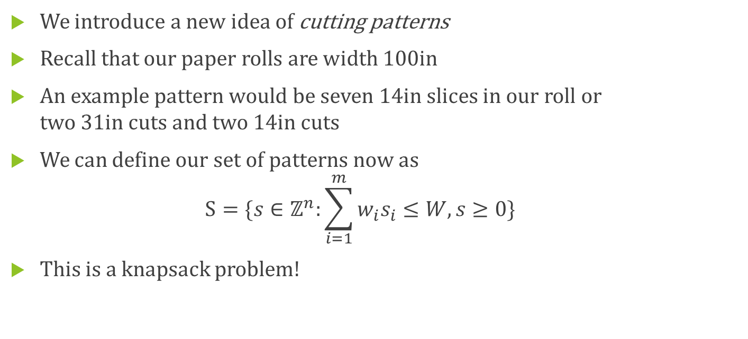
A New Approach
Order Width | Quantity Ordered
14 | 211
31 | 395
36 | 610
45 | 97
We introduce a new idea of cutting patterns
Recall that our paper rolls are width 100in
An example pattern would be seven 14in slices in our roll or two 31in cuts and two 14in cuts
We can define our set of patterns now as $S=\{s∈ℤ^{n}:\sum_{i=1}^{m}{w_{i}s_{i}≤W, s≥0\}}$
This is a knapsack problem!

Slide 7
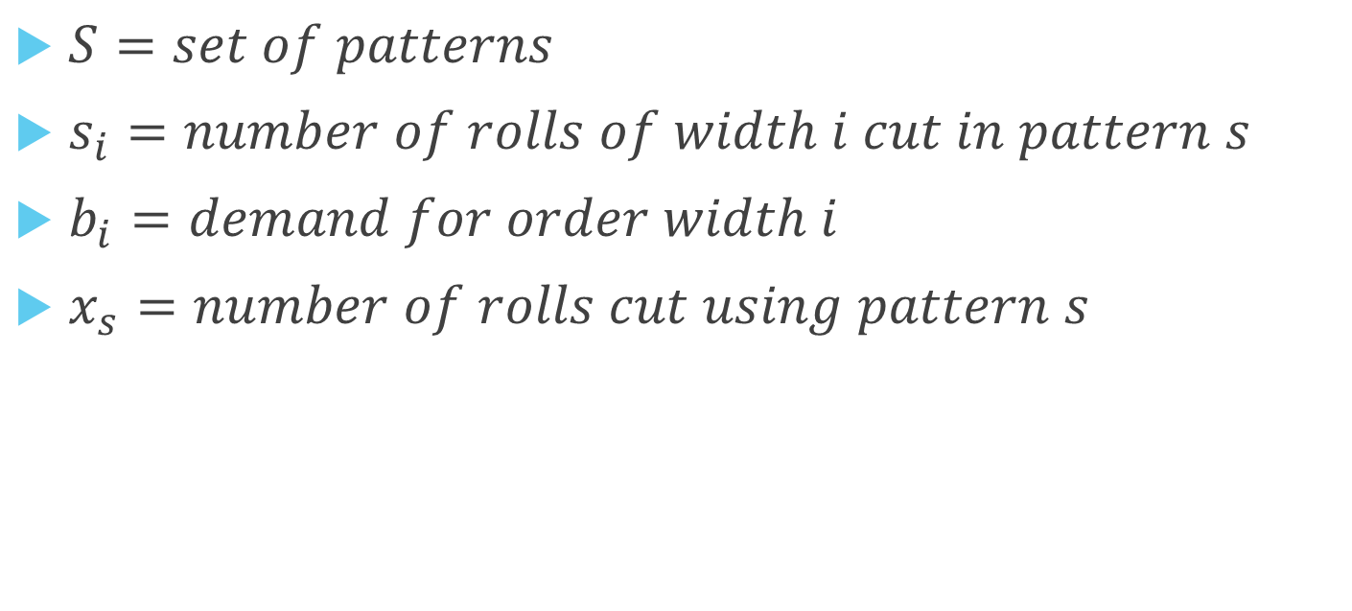
Alternative formulation
$S=set of patterns$
$s_{i}=number of rolls of width i cut in pattern s$
$b_{i}=demand for order width i$
$x_{s}=number of rolls cut using pattern s$

Slide 8
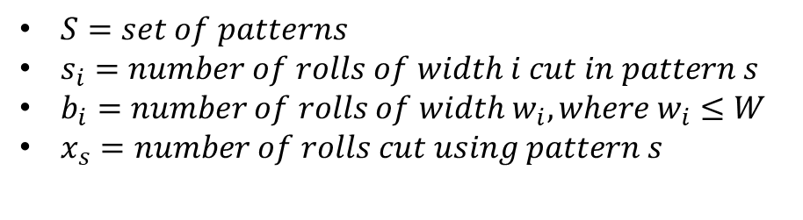

Alternative formulation cont’d
$$\min{\sum_{s∈S}{x_{s}}}$$ $subject to: \sum_{s∈S}{s_{i}x_{s}≥b_{i}, i=1}$,…,m $$x∈ℤ^{+}$$
$S=set of patterns$
$s_{i}=number of rolls of width i cut in pattern s$
$b_{i}=number of rolls of width w_{i},where w_{i}≤W$
$x_{s}=number of rolls cut using pattern s$

Slide 9
Gilmore and Gomory
We are going to need two linear programs!
We find the minimal number of rolls that need to be cut given a set of patterns
We generate new patterns that reduce the number of rolls used or tell us there is no more patterns
We will alternate solving these two problems repeatedly until no new patterns exist

Slide 10
3 different ways to solve!
Using just AMPL
Using just Python
Using Python to call AMPL

Slide 11
AMPL
Terminal
ampl: model Cutting.mod
ampl: data Cutting.dat;
problem Cutting_Opt: Cut, Number, Fill;
option relax_integrality 1;
problem Pattern_Gen: Use, Reduced_Cost, Width_Limit;
option relax_integrality 0;
let nPAT := 0;
for {i in WIDTHS} {
let nPAT := nPAT + 1;
let nbr[i,nPAT] := floor (roll_width/i);
let {i2 in WIDTHS: i2 <> i} nbr[i2,nPAT] := 0;
}
repeat {
solve Cutting_Opt;
let {i in WIDTHS} price[i] := Fill[i].dual;
solve Pattern_Gen;
if Reduced_Cost < -0.00001 then {
let nPAT := nPAT + 1;
let {i in WIDTHS} nbr[i,nPAT] := Use[i];
}
else break;
}
Model File
# ----------------------------------------
# CUTTING STOCK USING PATTERNS
# ----------------------------------------
param roll_width > 0; # width of raw rolls
set WIDTHS; # set of widths to be cut
param orders {WIDTHS} > 0; # number of each width to be cut
param nPAT integer >= 0; # number of patterns
set PATTERNS = 1..nPAT; # set of patterns
param nbr {WIDTHS,PATTERNS} integer >= 0;
check {j in PATTERNS}:
sum {i in WIDTHS} i * nbr[i,j] <= roll_width;
# defn of patterns: nbr[i,j] = number
# of rolls of width i in pattern j
var Cut {PATTERNS} integer >= 0; # rolls cut using each pattern
minimize Number: # minimize total raw rolls cut
sum {j in PATTERNS} Cut[j];
subject to Fill {i in WIDTHS}:
sum {j in PATTERNS} nbr[i,j] * Cut[j] >= orders[i];
# for each width, total
# rolls cut meets total orders
# ----------------------------------------
# KNAPSACK SUBPROBLEM FOR CUTTING STOCK
# ----------------------------------------
param price {WIDTHS} default 0.0;
var Use {WIDTHS} integer >= 0;
minimize Reduced_Cost:
1 - sum {i in WIDTHS} price[i] * Use[i];
subject to Width_Limit:
sum {i in WIDTHS} i * Use[i] <= roll_width;

Slide 12
Solution using AMPL
: 1 2 3 4 5 6
14 7 0 0 0 2 0
31 0 3 0 0 0 2
36 0 0 2 0 2 1
45 0 0 0 2 0 0
;
Cut [*] :=
1 0 2 0 3 100.75 4 48.5 5 105.5 6 197.5
;
ampl: solve;
Cut [*] :=
1 0 2 0 3 100 4 49 5 106 6 198
;
Order Width | Quantity Ordered
14 | 211
31 | 395
36 | 610
45 | 97

Slide 13
Python
m = Model('cutstock')
m.ModelSense = GRB.MINIMIZE
x = m.addVars(len(patterns), obj=1, vtype='C', name='x')
c1 = m.addConstrs((patterns[i][i] * x[i] >= d[i] for i in I), name='c1')
# ======================= Subproblem and Iteration ============================
for iter_count in count():
m.write('master_problem.lp')
m.optimize(keyboard_terminate)
price = [c1[i].pi for i in I]
print(f'Price = {price}')
sp = Model('subproblem') # Subproblem
sp.ModelSense = GRB.MAXIMIZE
use = sp.addVars(I, obj=price, vtype='I', name='use')
c2 = sp.addConstr(quicksum(w[i]*use[i] for i in I) <= W_roll)
sp.write('subproblem.lp')
sp.optimize(keyboard_terminate)
min_rc = 1 - sp.objVal
if min_rc < -TOL:
patterns.append([int(use[i].x) for i in I])
logger.info(f'min reduced cost = {min_rc:.4f};'
f' new pattern: {patterns[-1]}')
x[iter_count+len(I)] = m.addVar(obj=1, vtype='C',
column=Column(patterns[-1], c1.values()))
else:
break
Optimization packages available: gurobipy, cplex, etc….

Slide 14
Python calling AMPL
from amplpy import AMPL
# Create an AMPL instance
ampl = AMPL()
# Load the model
ampl.read(“cutting.mod")
# Load the data from pandas.DataFrame objects:
WIDTHS_df, ORDERS_df, roll_width_df = prepare_data()
# 1. Send the data from "amt_df" to AMPL and initialize the indexing set “WIDTH"
ampl.set_data(WIDTH_df, “WIDTH")
# 2. Send the data from "ORDERS_df" to AMPL and initialize the indexing set "ORDERS"
ampl.set_data(ORDERS_df, "ORDERS")
# 3. Set the values for the parameter "amt" using “roll_width_df"
ampl.get_parameter("amt").set_values(amt_df.unstack())
# Specify the solver to use
ampl.option["solver"] = “cplex"
# Solve
ampl.solve()
# Stop if the model was not solved
Python packages that can call AMPL: Pyomo, amplpy, etc…

Slide 15
Conclusion
These implementations are not unique to this optimization problem!
We can use AMPL, Python, or a combination to solve problems
We have to choose our formulation carefully otherwise it can lead to long run times or weak bounds

Slide 16
References
Conforti, Michele, et al. Integer Programming. Springer International Publishing, 2014.
Fourer, Robert, et al. AMPL a Modeling Language for Mathematical Programming. Brooks/Cole, 2009.
Sisca Octarina et al 2019 J. Phys.: Conf. Ser. 1282 012015
Gilmore, Paul and Gomory,Ralph “A Linear Programming Approach to the Cutting-Stock Problem” Operations Research, 1961, Vol. 9 p.849-859

Slide 17

Questions?

